Slide 1
OSRAM CONTINENTAL ROMANIA
location - Iasi
PRACHTECH 2021

Slide 2
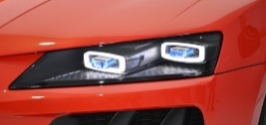
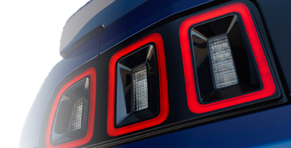
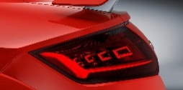
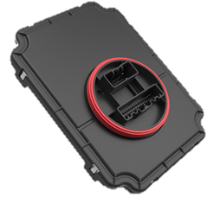
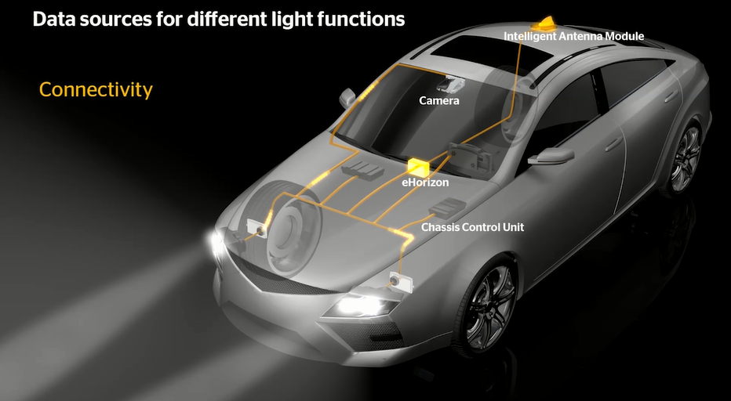
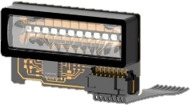
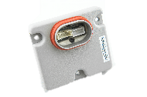
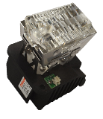
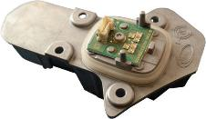
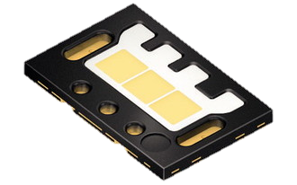
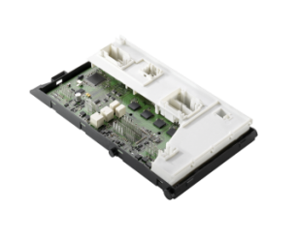
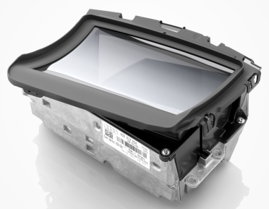
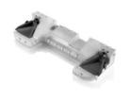
OSRAM Continental GmbH Two Strong Partners Combine Competencies
Portfolio / applications offered by the JV
Audi AG
Audi AG
Laser solutions
LED solutions
OLED solutions
Low Power LCU
Front-Light Controller
Vehicle Architecture
Matrix
LED driver
LED Engine
LED integrated Module
Algorithms for advanced Light functions
Partnership
Partnership
OSRAM Businesses
Continental Business Units
Opto Semiconductor
Specialty Lighting
Lighting Solution & Systems
Body Controller
Head-up Display
Multimedia & Cloud
Camera, Radar, Lidar Systems
Notes:
Components are not part of the Joint Venture, but the JV intends to offer solutions incl. OLED technology

Slide 3
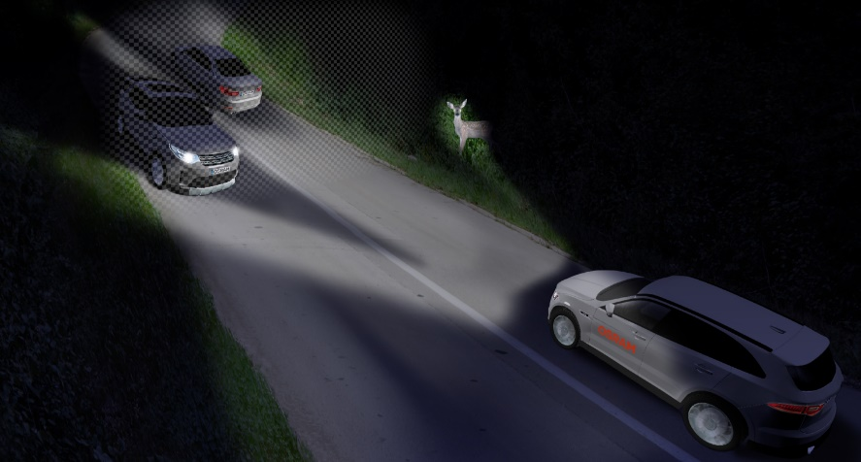
Osram continental covers the value chain from module to system
OSRAM Continental GmbH
LED
Module
Electronics
System
Fixture
Perfect combination of lighting and electronics know-how to meet customer demands
Leverage complementing R&D capabilities
Innovative lighting solutions which serve exactly their customer’s needs
Enable customer product offering and save their R&D resources
Parallel development of light, electronics, and software will fuel innovation and shorten time to market
Benefit from parents lighting and complete vehicle system know how
Global footprint and strong relation to major automotive customers

Slide 4
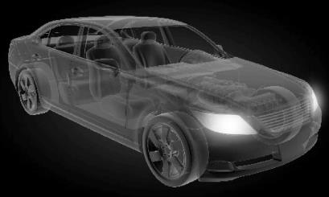
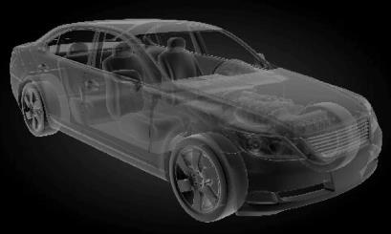
Intelligent Lighting Functions Integrated, Adaptive, Intelligent
Light ...
Light
+
Electronic
=
... merged with electronics
and getting embedded ...
Intelligent Light
... connected to board
electronics and systems ...
... is adaptive
...is becoming intelligent ...

Slide 5
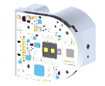
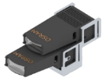
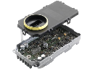
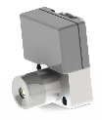
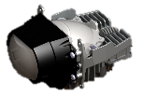
No intelligent light without OSRAM Continental
Interior lighting
Ambient lighting
Info projection
Rear light
Lightfunction algorithms
Light Control Units
Front lighting (LED, laser, matrix)
Signal lighting
Daytime running light

Slide 6
OSRAM Continental GmbH Worldwide Presence at DAY 1
Munich
Garching Herbrechtingen
Regensburg
_{Germany}
Troy
Hillsboro
Hendersonville
_{USA}
Vienna
_{Austria}
Toulouse
_{France}
Iasi
_{Romania}
Shanghai
Kunshan
_{China<}
Guadalajara
_{Mexico}
Treviso
_{Italy}
Bangalore
_{India}
HQ (global)
HQ (local)
R&D
Manufacturing

Slide 7
Iasi Romania

Slide 8
Osram Continental Romania
Address: Calea Chisinaului 26

Slide 9
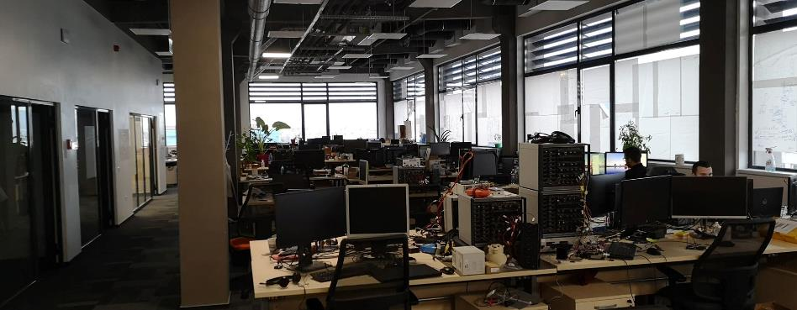
Iasi office building
overview
3 FLOORS AVAILABLE FOR RD AND SUPPORT FUNCTIONS
EXTENSION PLANNED FOR GARAGE ON THE GROUND FLOOR
LABORATORIES FOR HARDWARE TESTING (BASIC FUNCTIONS) AND TESTBENCHES

Slide 10
Competency Overview
Location Iasi
Project Management
Hardware Design & Validation
Technical project management from acquisition to SOP
Proven records on discipline level (software, testing)
Tracking of activities
Error management
Mechanical Design
Complete layout according to EMC/ESD rules
Complete design according to OEM specific hardware requirements
Verification of electrical requirements according to customer definition
EMC / ESD related validations
Product and design validation activities
3D models using CATIA v5 under OEM specific environment
Thermal and structural simulation
Software Development
System Engineering
System Test Engineering
Test automation in Python and other scripting solutions
Requirement Engineering
Application development
Generic development & integration for Lights function
Full range of diagnostic based on UDS (jobs & tools)
Project development based AUTOSAR 4.x platforms
Integration of various 3rd party software (e.g. drivers, libs)
Model based development (Matlab Simulink/Targetlink)
Test environment based on proprietary solutions
Matlab/Simulink and TestStand/LabView implementations in tool chains
Various functionality under test
Lifetime tester design & PTS
System Architecture
Project Engineering for Safety
Requirements Management
Advanced Software Algorithm

Slide 11
OSRAM CONTINENTAL Romania
Student opportunities
Internships for:
* Hardware Development
* Software Development
* Test Engineering
Diploma Project
* partnerships with university teachers
Hardware Development Technical Skills
- Basic electronics knowledge
Testing Technical Skills
- Basic electronics knowledge
- Basic Testing knowledge
Software Technical Skills
- Basic knowledge of C embedded or C++ programming language
- Basic knowledge of microcontrollers
General Skills
- Fast learning abilities
- Drive and Initiative
- Good command of English language
Apply at https://www.osram-continental.com/career

Slide 12
Thank you

